Slide 1


Experimental Design
Sara Bengtsson
With thanks to:
Christian Ruff
Rik Henson

Slide 2
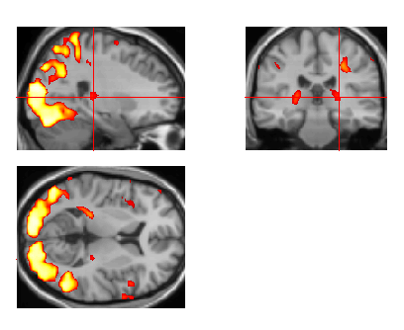
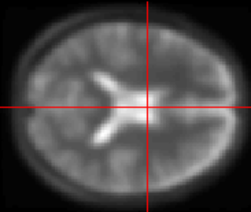
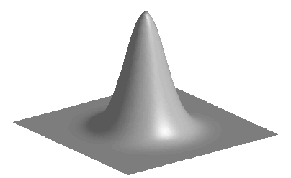
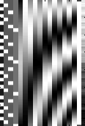
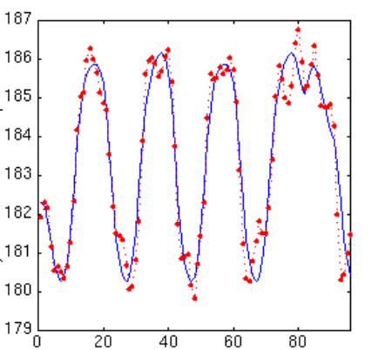
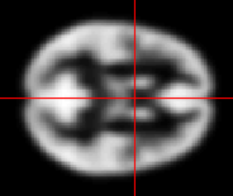
Statistical parametric map (SPM)
Image time-series
Kernel
Design matrix
Realignment
Smoothing
General linear model
Statistical
inference
Gaussian
field theory
Normalisation
Template
p <0.05
Parameter estimates

Slide 3
Overview
Task A – Task B
Categorical designs
Subtraction - Pure insertion, evoked / differential responses
Conjunction - Testing multiple hypotheses
Parametric designs
Linear - Adaptation, cognitive dimensions
Nonlinear - Polynomial expansions, neurometric functions
- Model-based regressors
Factorial designs
Categorical - Interactions and pure insertion
Parametric - Linear and nonlinear interactions
- Psychophysiological Interactions (PPI)
a A A A A

Slide 4
Cognitive subtraction
Aim
  Neuronal structures underlying a single process P
Procedure
  Contrast: [Task with P] – [matched task without P ] → P
  >> The critical assumption of „pure insertion“

Slide 5
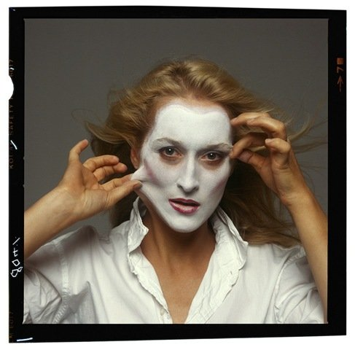


Cognitive subtraction: Interpretations
Question
Which neural structures support face recognition?
Distant stimuli
vs.
→ Several components differ!
Related stimuli
vs.
→ P implicit in control task?
Meryl Streep Mum?!
Same stimulus, different tasks
vs.
→ Interaction of process and task?
Name the person! Name gender!

Slide 6
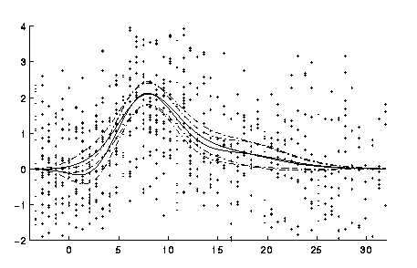
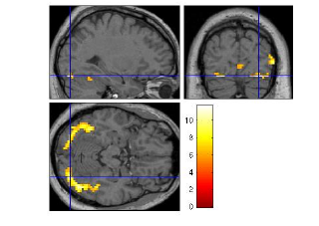
Evoked responses
Faces vs. baseline ‘rest’
Peri-stimulus time {sec}
Null events or long SOAs essential for estimation,
which may result in an inefficient design.
“Cognitive” interpretation hardly possible, but useful
to define regions generally involved in the task.
Can be useful as a mask to define regions of interests.

Slide 7
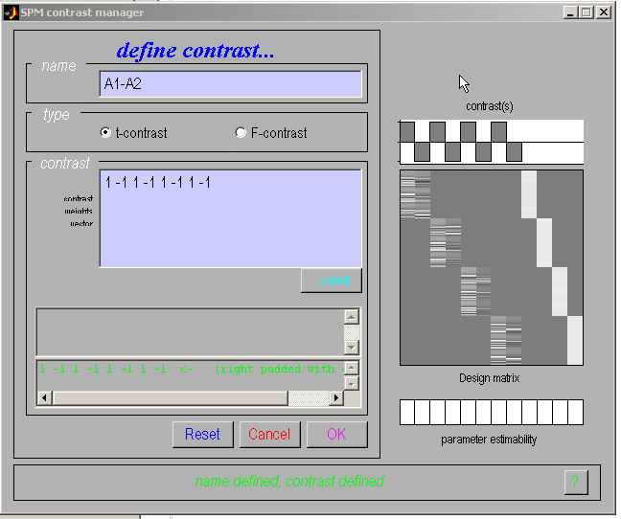
Categorical responses
Task 1
Task 2
Session

Slide 8
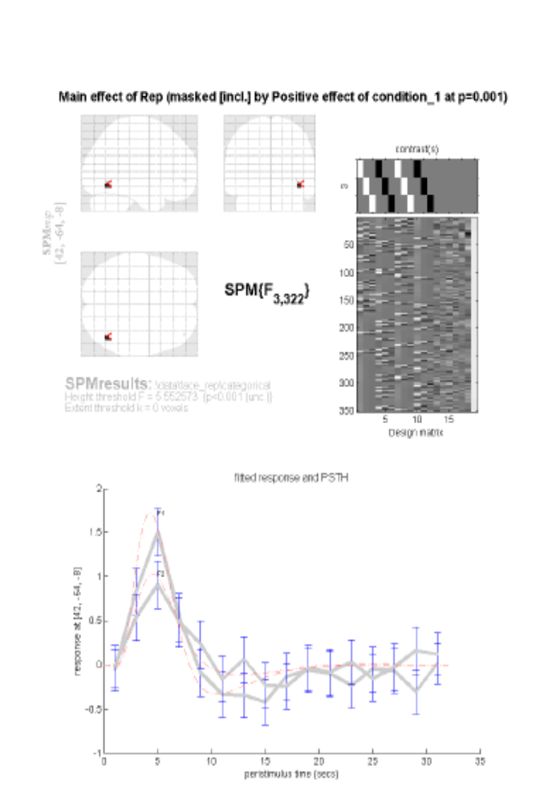
Categorical response
Famous faces: 1st time vs. 2nd time
Peri-stimulus time {sec}
Mask:
Faces vs. baseline.
Henson et al., (2002)

Slide 9
Overview
Categorical designs
Subtraction - Pure insertion, evoked / differential responses
Conjunction - Testing multiple hypotheses
Parametric designs
Linear - Adaptation, cognitive dimensions
Nonlinear - Polynomial expansions, neurometric functions
- Model-based regressors
Factorial designs
Categorical - Interactions and pure insertion
Parametric - Linear and nonlinear interactions
- Psychophysiological Interactions

Slide 10
Conjunction
One way to minimize “the baseline problem” is to isolate
the same cognitive process by two or more separate contrasts,
and inspect the resulting simple effects for commonalities.
Conjunctions can be conducted across different contexts:
  tasks
  stimuli
  senses (vision, audition)
  etc.
Note: The contrasts entering a conjunction have to be truly independent.

Slide 11
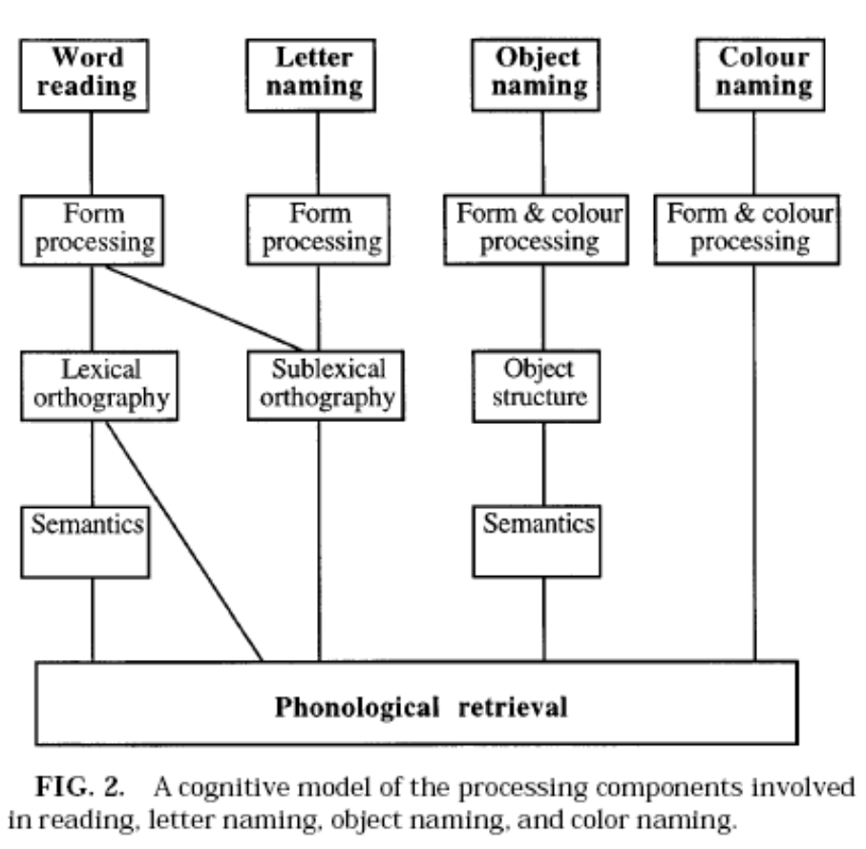
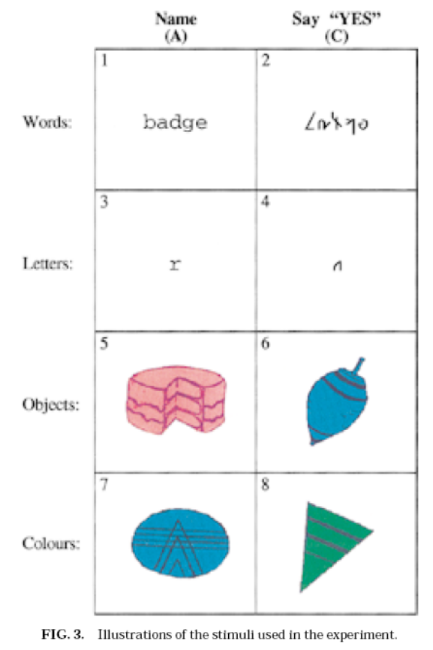
Conjunction: Example
Question
Which neural structures support phonological retrieval, independent of item?
Price et al., (1996); Friston et al., (1997)

Slide 12
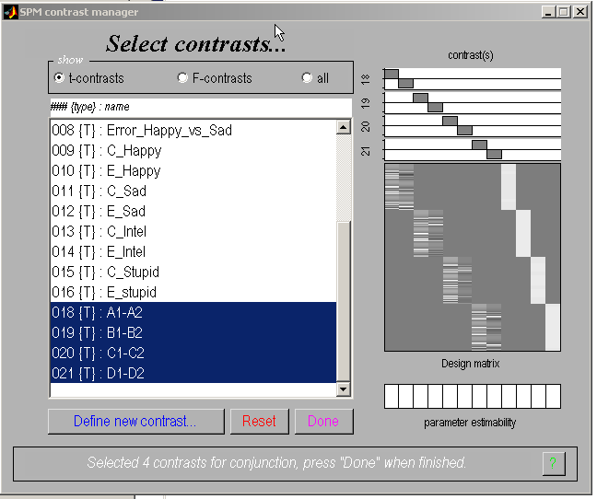
Conjunction specification
1 task/session

Slide 13
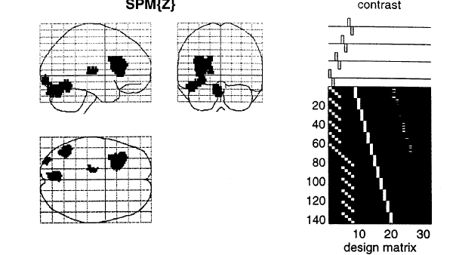
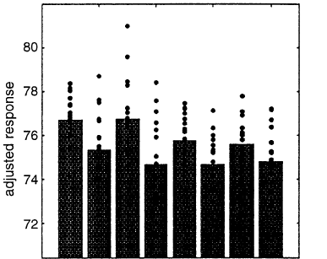
Conjunction: Example
Friston et al., (1997)

Slide 14
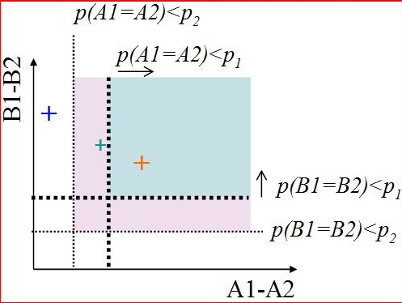
Conjunction: 2 ways of testing for significance
SPM8 offers two general ways to test
the significance of conjunctions.
Test of global null hypothesis:
Significant set of consistent effects
“which voxels show effects of similar direction (but not necessarily individual significance) across contrasts?”
Test of conjunction null hypothesis:
Set of consistently significant effects
“which voxels show, for each specified contrast,
effects > threshold?”
Friston et al., (2005). Neuroimage, 25:661-7.
Nichols et al., (2005). Neuroimage, 25:653-60.

Slide 15
Overview
Categorical designs
Subtraction - Pure insertion, evoked / differential responses
Conjunction - Testing multiple hypotheses
Parametric designs
Linear - Adaptation, cognitive dimensions
Nonlinear - Polynomial expansions, neurometric functions
- Model-based regressors
Factorial designs
Categorical - Interactions and pure insertion
Parametric - Linear and nonlinear interactions
- Psychophysiological Interactions

Slide 16
Parametric Designs
Varying the stimulus-parameter of interest on a continuum,
in multiple (n>2) steps...
  ... and relating BOLD to this parameter
  Possible tests for such relations are manifold:
        Linear
        Nonlinear: Quadratic/cubic/etc.
        „Data-driven“ (e.g., neurometric functions, computational modelling)

Slide 17
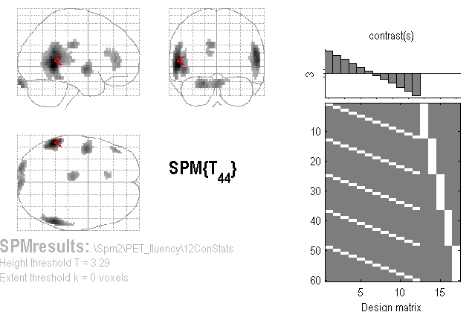
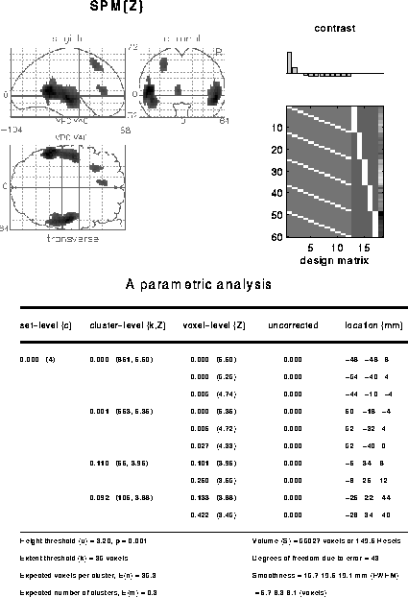
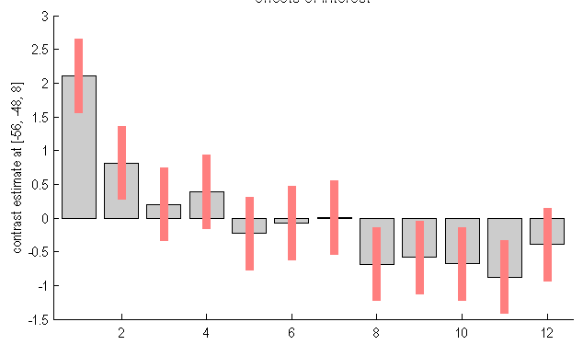
A linear parametric contrast
Linear effect of time
Non-linear effect of time

Slide 18
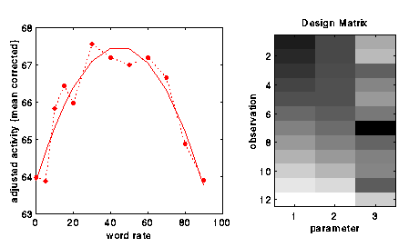
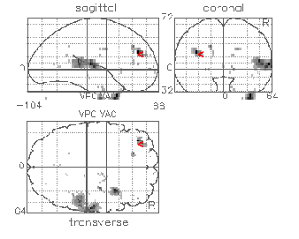
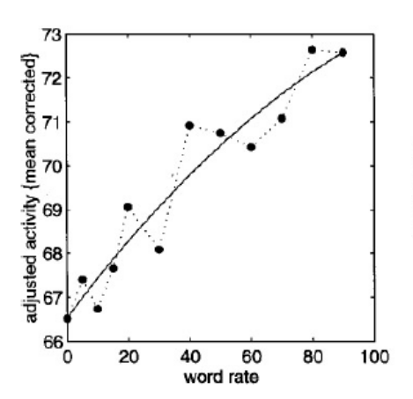
A non-linear parametric design matrix
F-contrast [1 0] on linear param
F-contrast [0 1] on quadratic param
Polynomial expansion:
f(x) ~ b₁ x + b₂ x² + ...
…up to (N-1)th order for N levels
SPM8 GUI offers polynomial
expansion as option during creation
of parametric modulation regressors.
SPM{F}
Linear
Quadratic
Buchel et al., (1996)

Slide 19
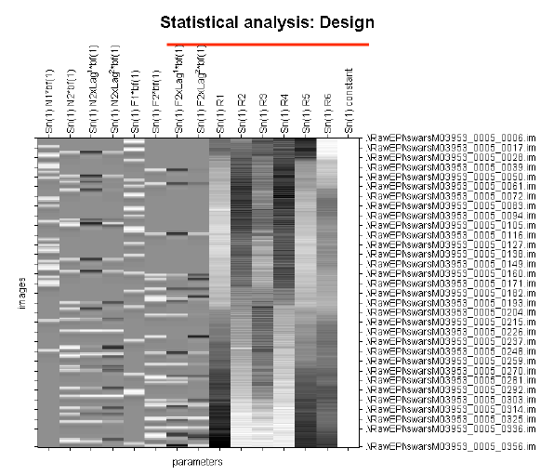
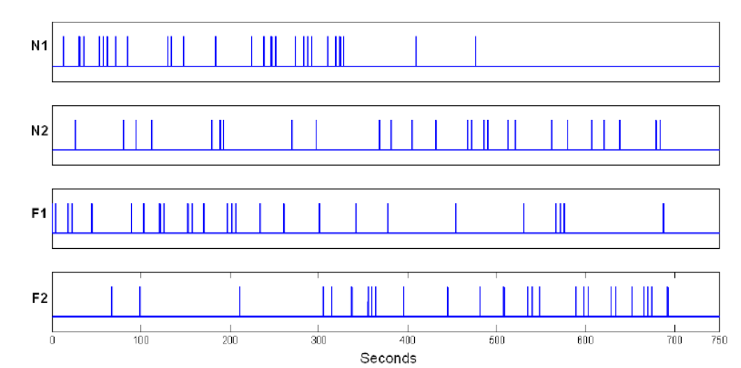
Parametric modulation
Quadratic param regress
Linear param regress
Delta function
seconds
Delta
Stick function
Parametric
regressor

Slide 20
Parametric design: Model-based regressors
In model-based fMRI, signals derived from a computational model for a specific cognitive process are correlated against BOLD from participants performing a relevant task, to determine brain regions showing a response profile consistent with that model.
The model describes a transformation between a set of stimuli inputs and a set of behavioural responses.
See e.g. O’Doherty et al., (2007) for a review.

Slide 21
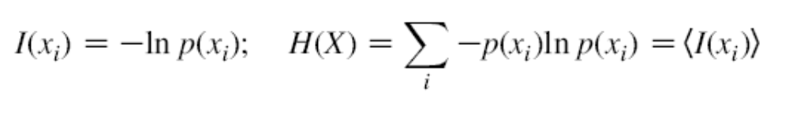
Model-based regressors: Example
Question
Is the hippocampus sensitive to the probabilistic context established by event streams? Rather than simply responding to the event itself.
The same question can be formulated in a quantitative way by using the information theoretic quantities ‘entropy’ and ‘surprise’.
‘surprise’ is unique to a particular event and measures its improbability.
‘entropy’ is the measure of the expected, or average, surprise over all events,
reflecting the probability of an outcome before it occurs.
xi is the occurrence of an event. H(X) quantifies the expected info of events sampled from X.
Thus, hippocampus would be expected to process ‘entropy’ and not ‘surprise’.

Slide 22
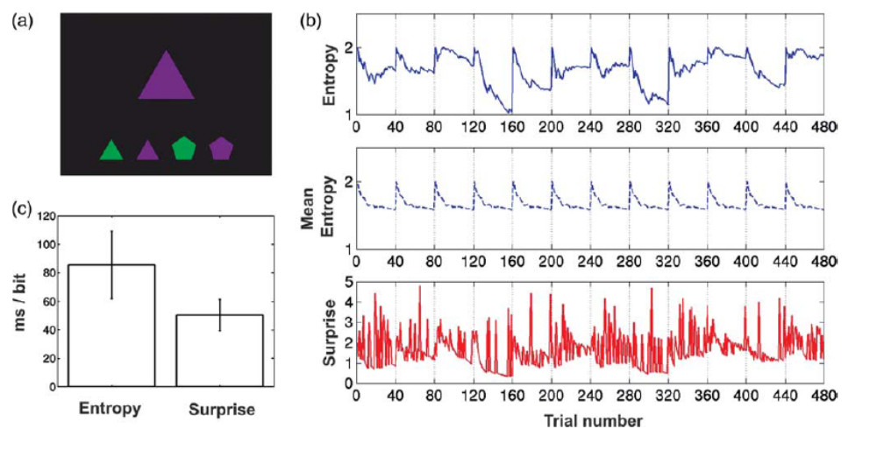
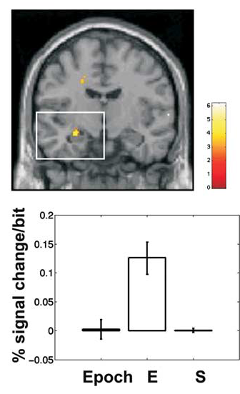
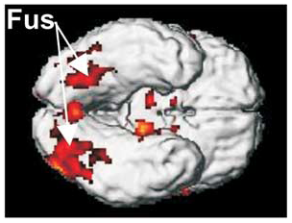
Model-based regressors: Example
Participants responded to the sampled item by pressing a key to indicate the position of that item in the row of alternative coloured shapes.
The participants will learn the
probability with which a cue appears.
Strange et al., (2005)

Slide 23
Overview
Categorical designs
Subtraction - Pure insertion, evoked / differential responses
Conjunction - Testing multiple hypotheses
Parametric designs
Linear - Adaptation, cognitive dimensions
Nonlinear - Polynomial expansions, neurometric functions
- Model-based regressors
Factorial designs
Categorical - Interactions and pure insertion
Parametric - Linear and nonlinear interactions
- Psychophysiological Interactions

Slide 24
Factorial designs: Main effects and Interaction
Factor A
a
A
B
a B
A B
Factor B
b
a b
A b

Slide 25
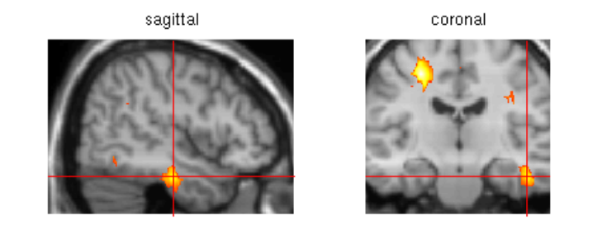
Factorial designs: Main effects and Interaction
Question
Is the inferiotemporal cortex sensitive to both object recognition and phonological retrieval of object names?
say ‘yes’
Non-object
a. Visual analysis and speech.
b. Visual analysis, speech,
and object recognition.
c. Visual analysis, speech,
object recognition, and phonological retrieval.
say ‘yes’
Object
a
b
c
name
Object
Friston et al., (1997)

Slide 26
Factorial designs: Main effects and Interaction
name say ‘yes’
Main effect of task (naming): (O n + N n) – (O s + N s)
Main effect of stimuli (object): (O s + O n) – (N s + N n)
Interaction of task and stimuli: (O n + N s) – (O s + N n)
Objects
Non-objects
Can show a failure of pure insertion
interaction effect
(Stimuli x Task)
‘Say yes’ (Object vs Non-objects)
Phonological retrieval (Object vs Non-objects)
Inferotemporal (IT) responses do discriminate between situations where phonological retrieval
is present or not. In the absence of object recognition, there is a deactivation in IT cortex, in the
presence of phonological retrieval.
Friston et al., (1997)

Slide 27
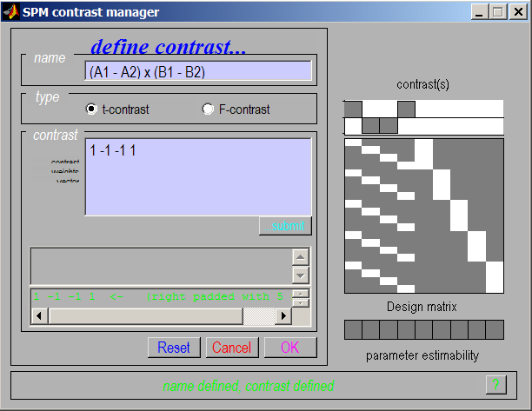
Interaction and pure insertion
Interactions:
cross-over
and
simple
We can selectively inspect our data for one or the other by masking during inference

Slide 28
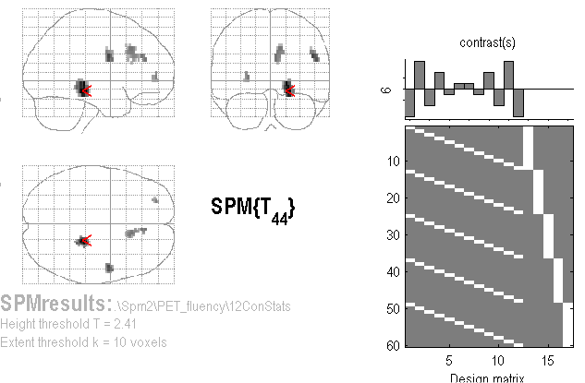
Linear Parametric Interaction
Question
Are there different kinds of adaptation for Word generation and Word repetition as a function of time?
A (Linear)
Time-by-Condition
Interaction
(“Generation strategy”?)
Contrast:
[5 3 1 -1 -3 -5](time) ⊗ [-1 1] (categorical)
= [-5 5 -3 3 -1 1 1 -1 3 -3 5 -5]

Slide 29

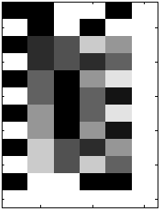
Non-linear Parametric Interaction
F-contrast tests for
Generation-by-Time interaction
(including both linear and
Quadratic components)
Factorial Design with 2 factors:
Gen/Rep (Categorical, 2 levels)
Time (Parametric, 6 levels)
Time effects modelled with both linear and quadratic components…
G-R
Time
Lin
Time
Quad
G x T
Lin
G x T
Quad

Slide 30
Overview
Categorical designs
Subtraction - Pure insertion, evoked / differential responses
Conjunction - Testing multiple hypotheses
Parametric designs
Linear - Adaptation, cognitive dimensions
Nonlinear - Polynomial expansions, neurometric functions
-Model-based regressors
Factorial designs
Categorical - Interactions and pure insertion
Parametric - Linear and nonlinear interactions
- Psychophysiological Interactions (PPI)

Slide 31
Psycho-physiological Interaction (PPI)
With PPIs we predict physiological responses in one part of the brain
in terms of an interaction between task and activity in another part of the brain.

Slide 32
Psycho-physiological Interaction (PPI)
Contextual specialization through top-down influences
Functional connectivity measure
If two areas are interacting they will display synchronous activity.

Slide 33
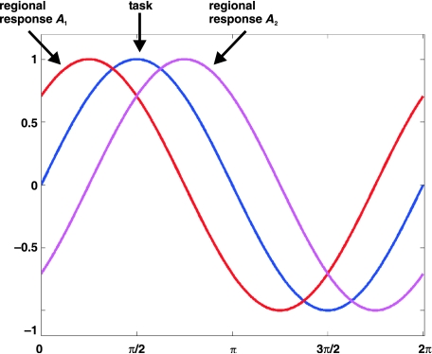
Psycho-physiological Interaction (PPI)
GLM based analysis
Stephan, 2004
No empirical evidence in these results of top-down influences.

Slide 34
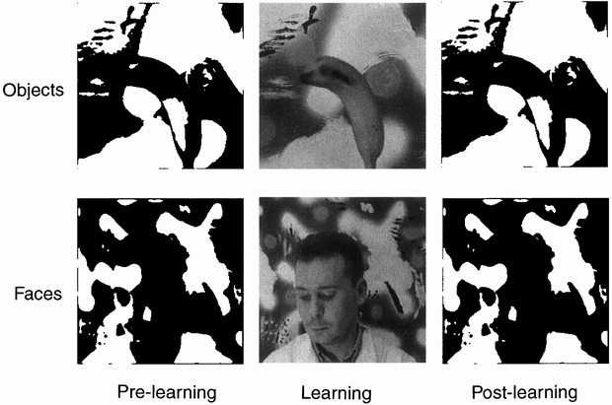
Psycho-physiological Interaction (PPI)
Example:
Learning
pre
post
Objects
Stimuli
Faces
Dolan et al., 1997

Slide 35
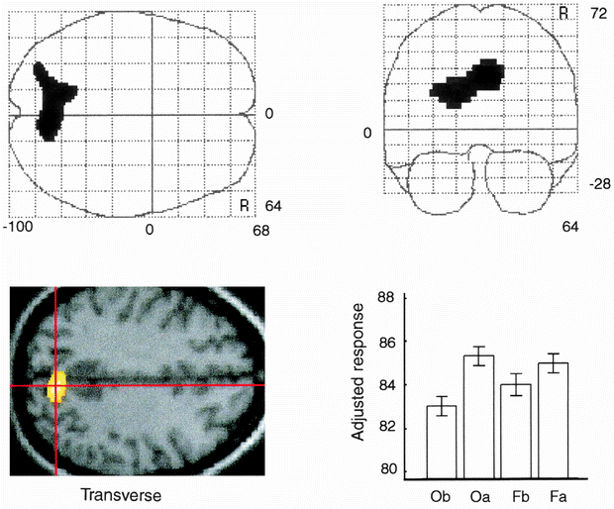
Psycho-physiological Interaction (PPI)
Main effect of learning:
Learning
pre
post
Objects
Stimuli
Faces

Slide 36
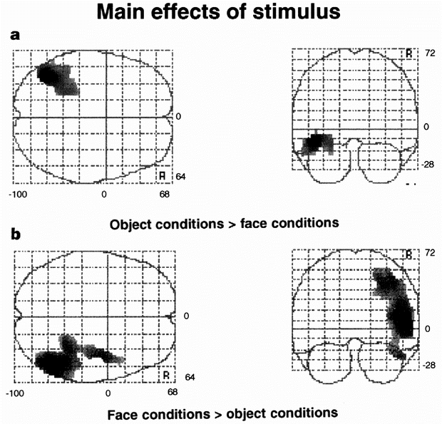
Psycho-physiological Interaction (PPI)
Question: Does learning involve functional connections between parietal cortex and stimuli specific
areas?
Learning
pre
post
Objects
Stimuli
Faces

Slide 37
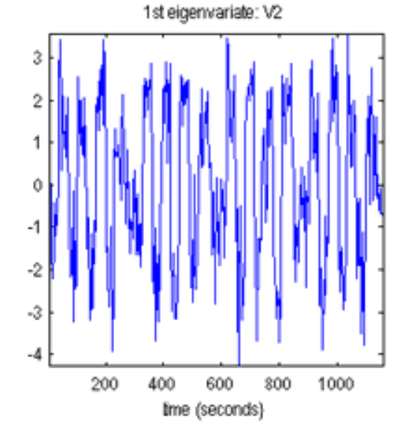
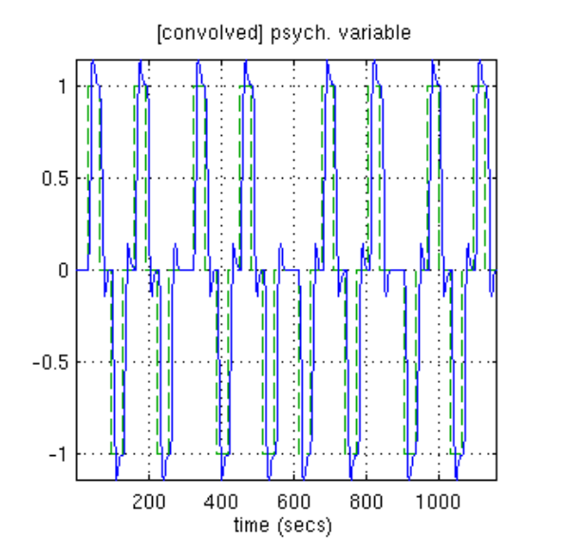
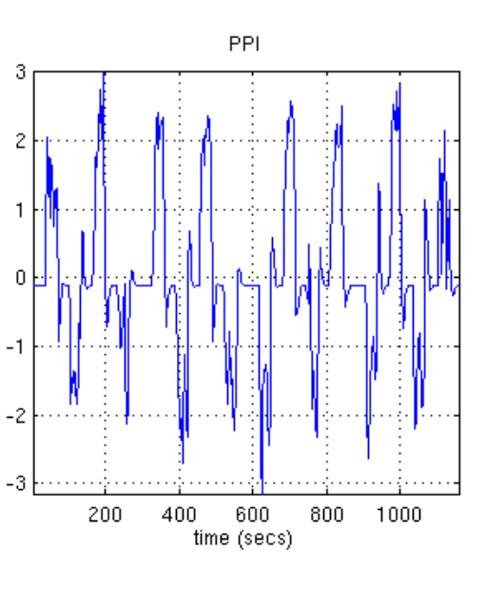
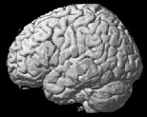
Psycho-physiological Interaction (PPI)
Question: Does learning involve functional connections between parietal cortex and stimuli specific
areas?
Activity in parietal cortex
(main eff Learning)
Faces - Objects
the product (PPI)
X
=
Seed region
One-to-one whole brain

Slide 38
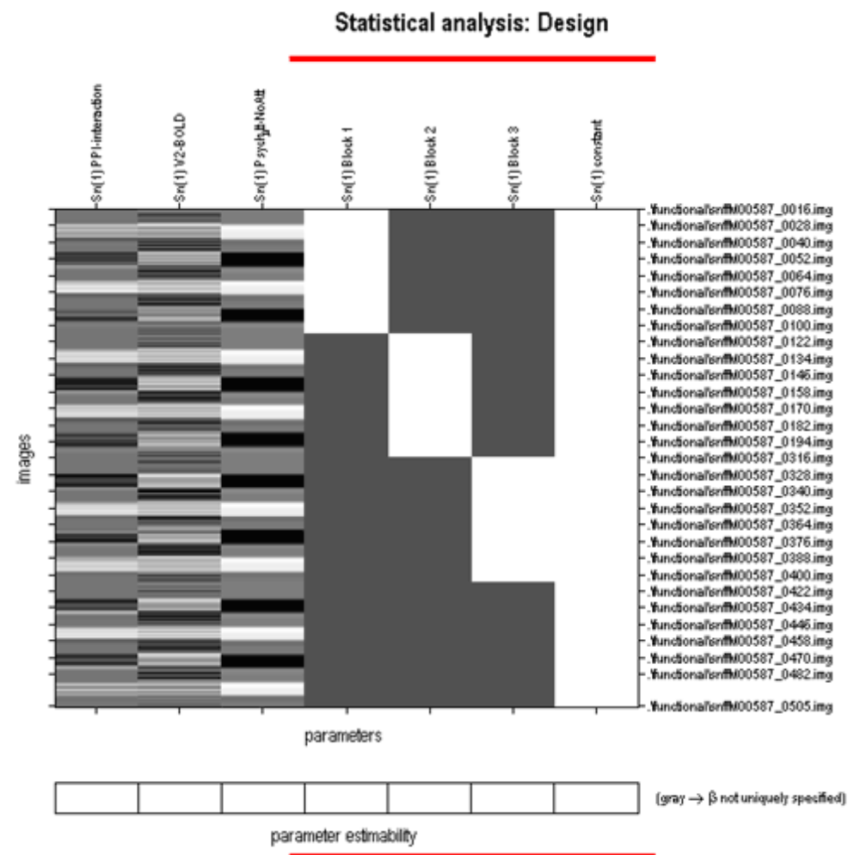
Regressors of no interest
The interaction term should account for variance over and above what is accounted for by the
main effect of task and physiological correlation
1 0 0
Activity in parietal cortex
(main eff Learning)
Faces - Objects
the product (PPI)
Task unspecific
neuromodulatory fluctuations
PPI activity stimuli
Shared task related correlation that
we already knew from GLM

Slide 39
Factorial designs in PPI
Activity in parietal cortex
(main eff Learning)
Faces - Objects
the product (PPI)
1 0 0
Learning
pre
post
Objects
Stimuli
PPI activity stimuli
Faces
Orthogonal contrasts reduce correlation between PPI vector and the regressors of no interest

Slide 40
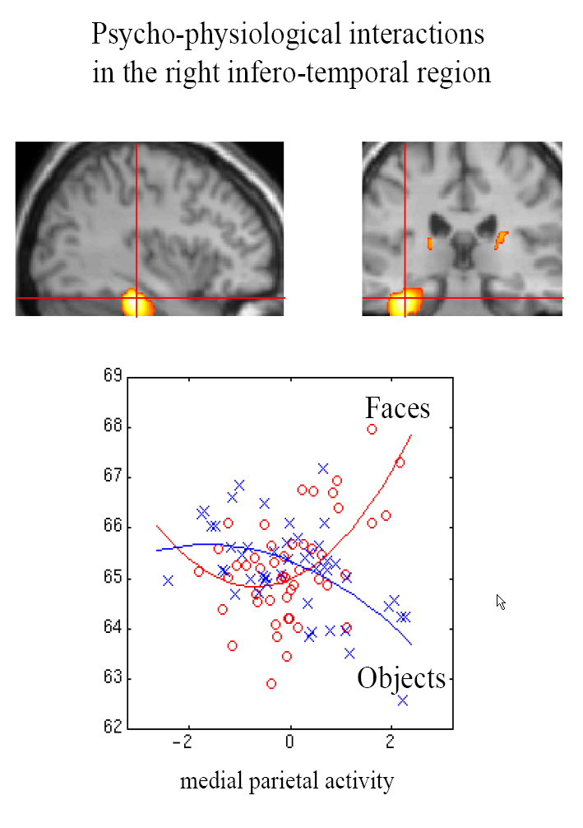
Psycho-physiological Interaction (PPI)
Question: Does learning involve effective connections between parietal cortex and stimuli specific
areas?
Inferiotemporal cortex discriminates
between faces and objects only when
parietal activity is high.
Right inf temp area
Friston et al., 1997; Dolan et al., 1997

Slide 41
Psycho-physiological Interaction (PPI)
Interpretations:
Stimuli:
Faces or objects
Set
Modulation of
stimulus-specific
responses
Context-sensitive
connectivity
PPC
source
IT
target

Slide 42
Overview
Categorical designs
Subtraction - Pure insertion, evoked / differential responses
Conjunction - Testing multiple hypotheses
Parametric designs
Linear - Adaptation, cognitive dimensions
Nonlinear - Polynomial expansions, neurometric functions
- Model-based regressors
Factorial designs
Categorical - Interactions and pure insertion
Parametric - Linear and nonlinear interactions
- Psychophysiological Interactions (PPI)

